Slide 1
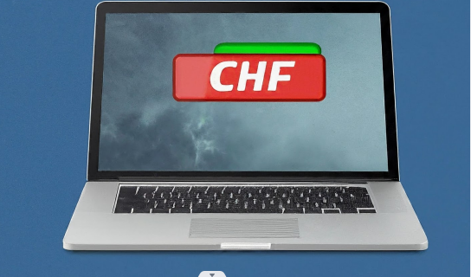
Free Up Your C Drive in 5 Easy Steps
This is a simple process to clone your data of information from C drive to D drive on HP laptop. This will help free up space on C drive and keep your data or information safe on D drive.

Slide 2
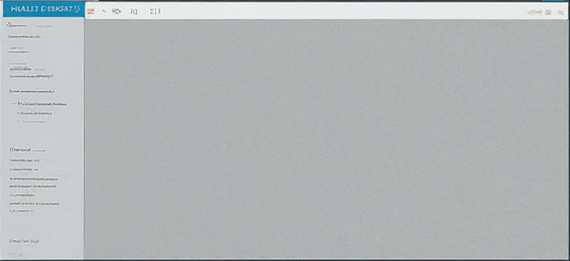
Identify The Contact Location.
Open "File Explorer" (Windows Key + E)
Click on your Username on the left panel (e.g., Documents, Pictures)
Locate the "Contacts" folder.

Slide 3
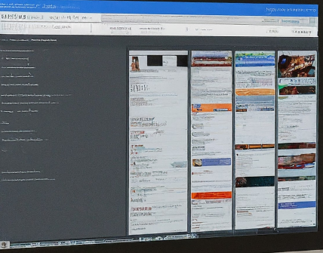
Copying Contacts
Right-click on the "data or information" folder
Select "Cut"
Once we've identified the "data or information" folder, we'll proceed to copy it. Here, we'll use the "Cut" function to ensure the folder is removed from its original location after copying.

Slide 4
Pasting to Local Disk D
Navigate to Local Disk D (usually labeled "D:") in the left panel
Right-click on any empty space within Local Disk D
Select "Paste"

Slide 5
Confirmation and Verification
Open Local Disk D (D:)
Verify that the "data or information" folder is successfully pasted
(Optional) Open your data or information application and confirm your contacts are present
By highlighting these built-in tools (Windows Key + E shortcut, File Explorer context menu options - Cut, Paste), your friend will understand they don't need any additional software to clone their contacts. This keeps the process simple and leverages the features already available on their HP laptop.

